Slide 1
Alien Invaders
Steven Vartanian
4/14/2021

Slide 2

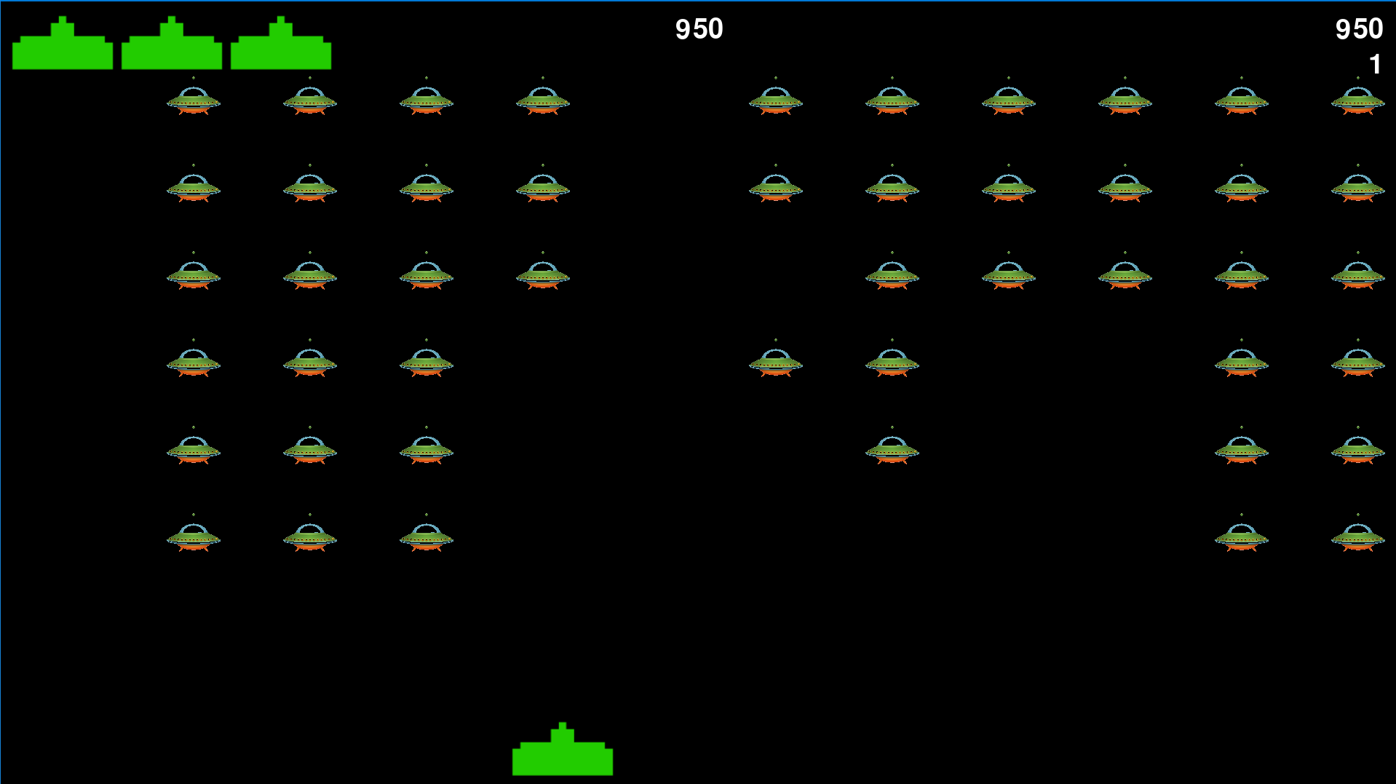
Why alien Invaders?
One of the first video games I played was space invaders on my brothers Atari. I thought it would be awesome to recreate a version of this game.
Using Pygame and transparent images I was able to create the visual component of this project
Creating this version of the game really brought back many memories and implementing my own ideas to make the game harder was awesome.

Slide 3
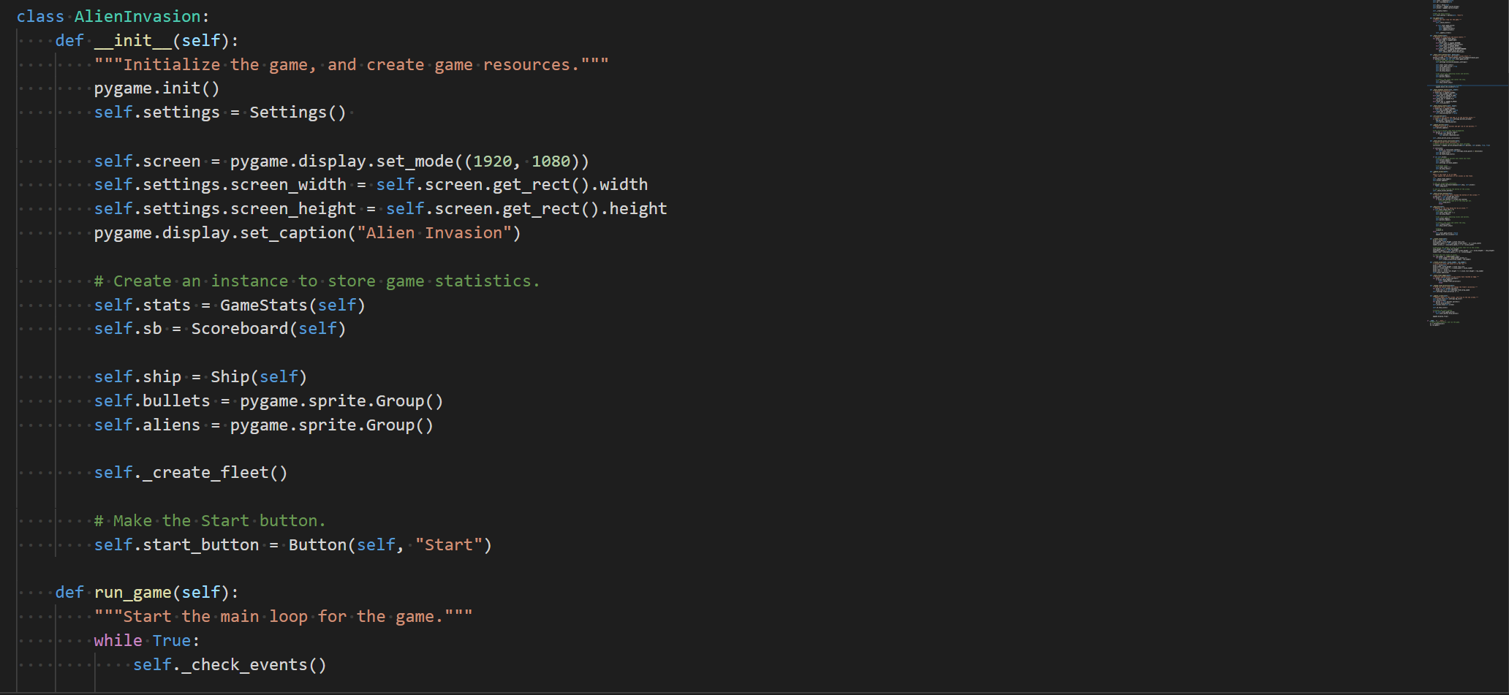
Alien Invasion Class
This is the main class that actually runs the game and creates the game features on the screen.
The class is also responsible for checking key inputs, bullet events, creating the alien fleet, and detecting collisions.

Slide 4
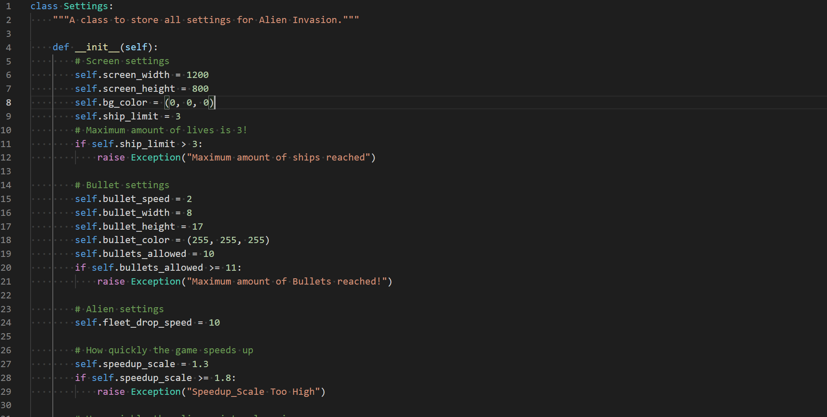
Settings class
This class stores all the games settings for all the functions that live in other files of Alien Invasion.

Slide 5
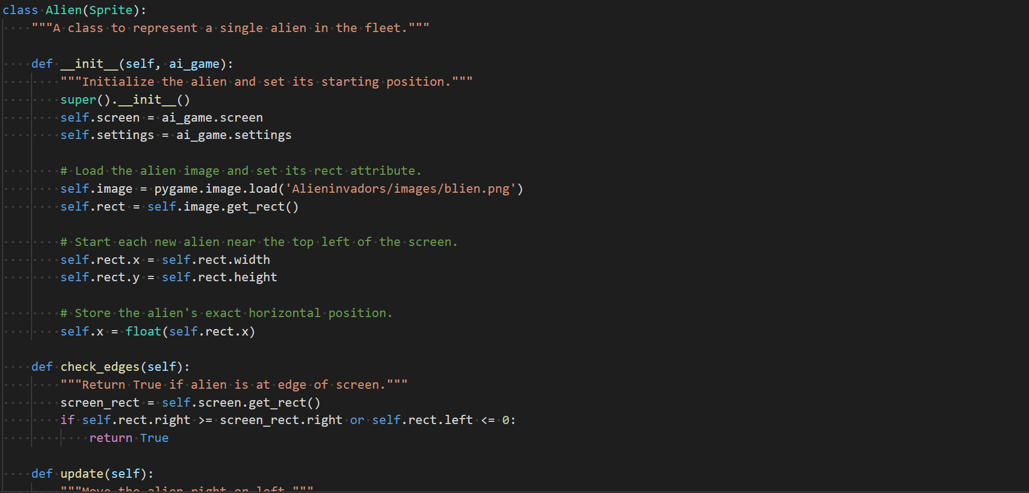
Alien Class
This class loads the alien in the top left on the screen, moves the alien right and left and also detects if the alien hits the edge of the screen.

Slide 6
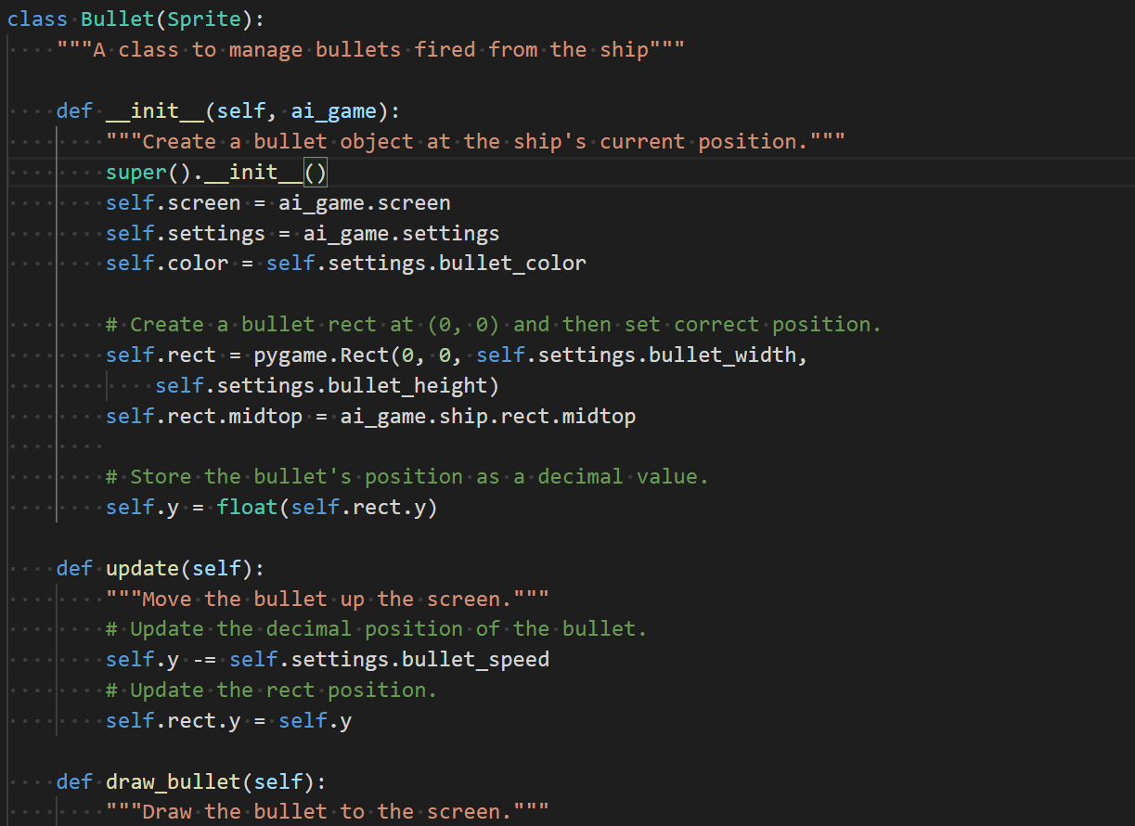
Bullet Class
This class creates, draws and manages the bullets fired from the ship!

Slide 7
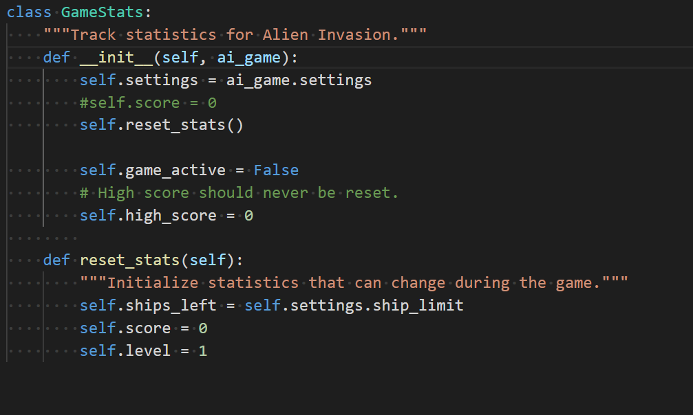
Game Stats class
This class tracks the score of the destroyed alien ships and creates a high score that shows of you were to lose the game.

Slide 8
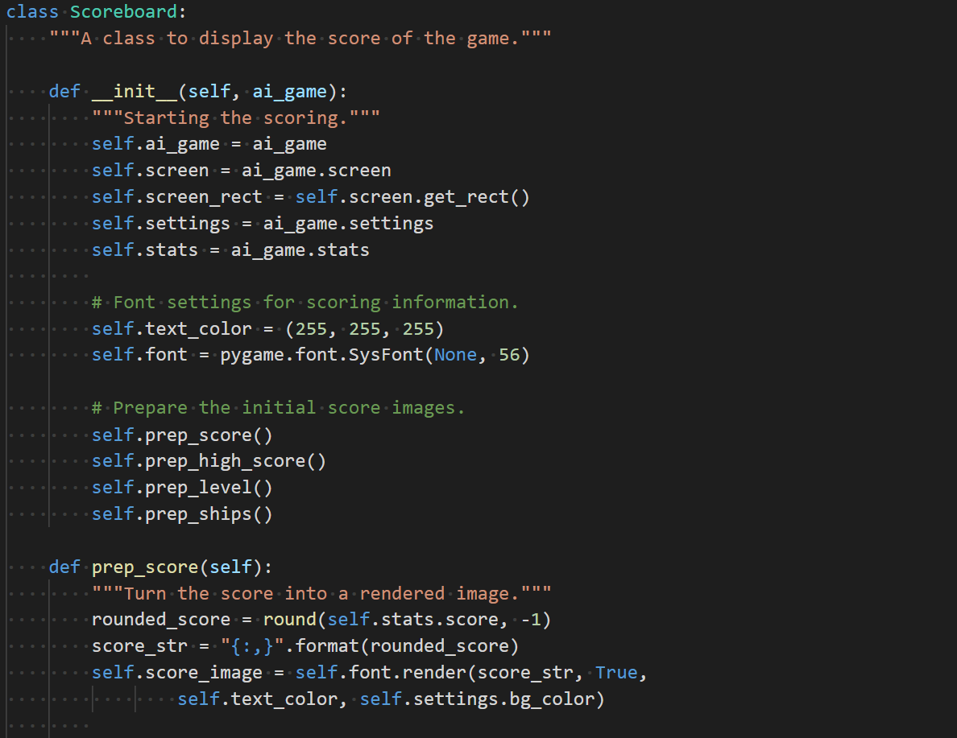
Scoreboard class
This class creates a scoring system for destroying ships and prints this score as an image on the top center and right side of the screen.

Slide 9
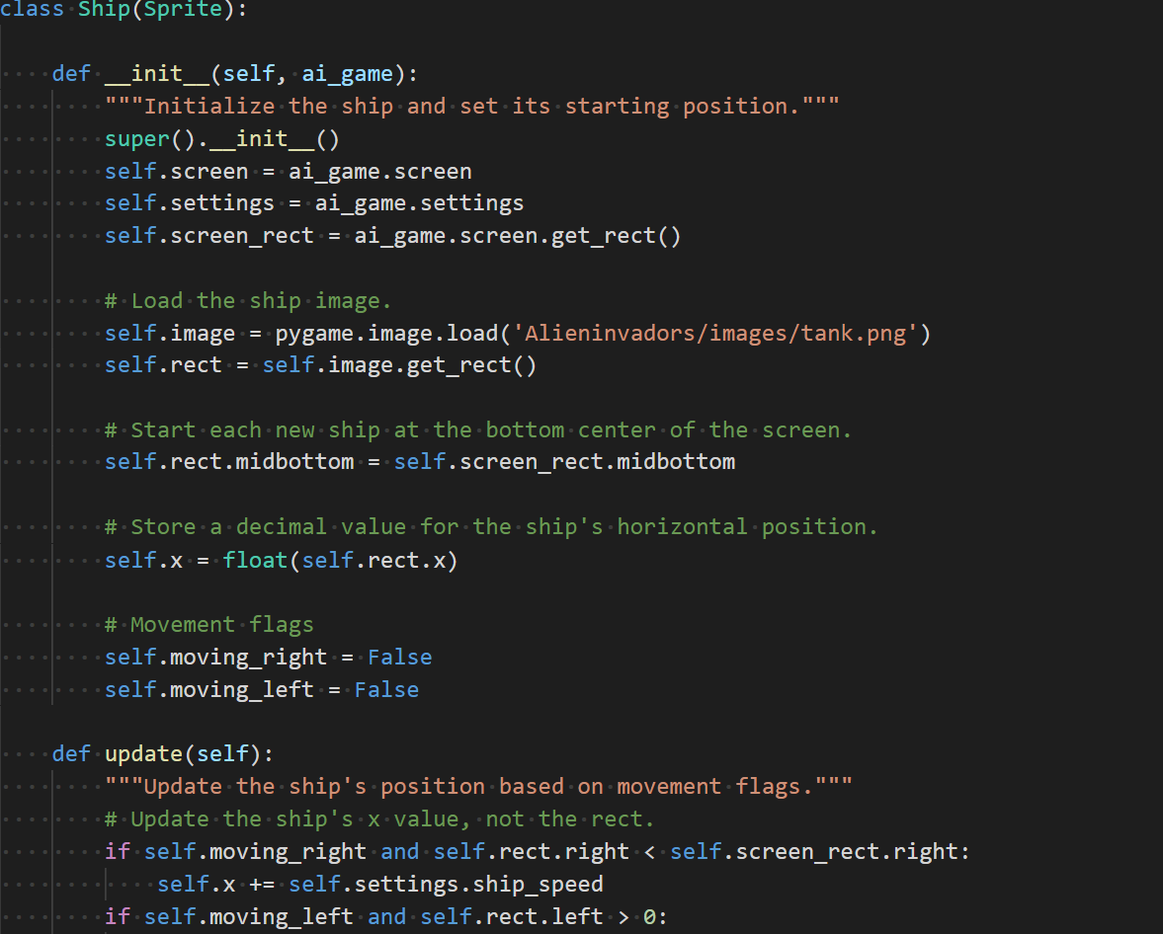
Ship class
This class defines the ship and creates the ship using a transparent image.

Slide 10
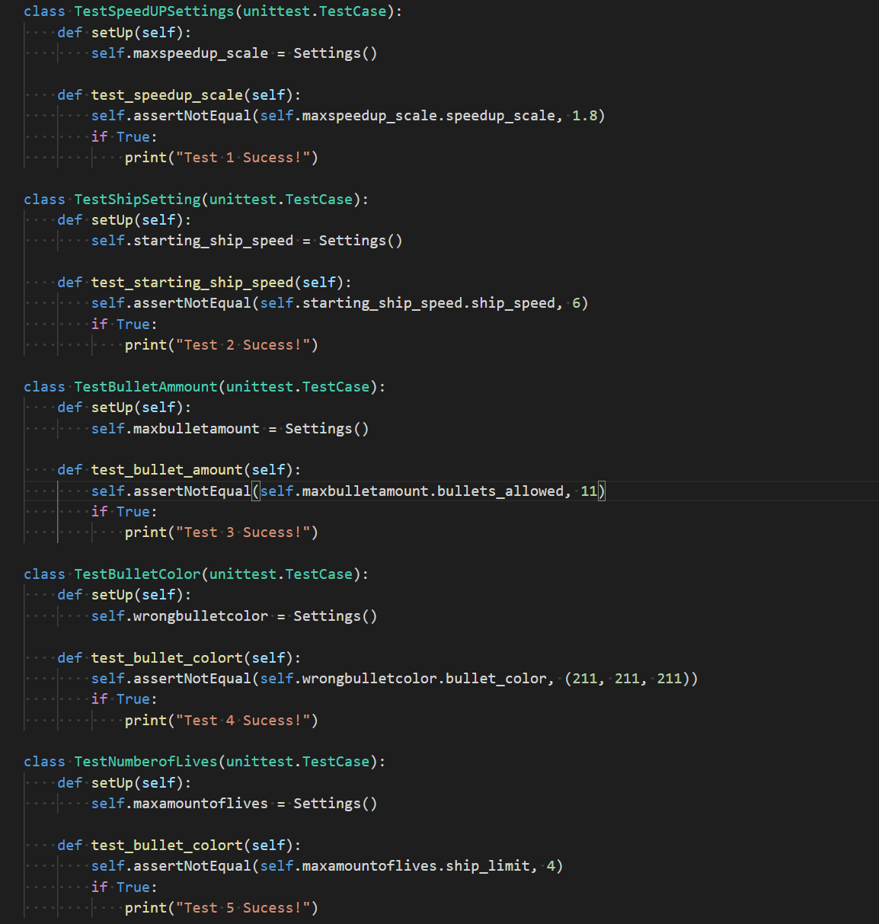
Test Cases
The speed up test verifies that the speed up setting is not more than 1.8.
The ship test makes sure the starting ship speed does not exceed 5.
The bullet test makes sure that there is not more than 10 bullets fired at once.
The bullet color tests to make sure the color will be visible for the user.
The lives test makes sure there is not an excessive number of lives for the user.

Slide 11

Exceptions
The defined exceptions are risen when a test case were to fail and will print out a message regarding what failed.
Raised when the maximum amount of ships reached.
Raised when the wrong bullet color is used.
Raised when the maximum amount of bullets is reached.
Raised when the speed up scale is too high.
Raised when the starting speed is too high.

Slide 12
What I learned!
This was my first time taking on a coding project like this and I really learned a lot on proper coding style. I was making little mistakes because I was typing fast trying while paying less attention to formatting which cause some issues when running the game at first.
When I implemented a background image instead of a background color the game became unplayable because to hard to focus on the aliens with a distracting image in the background.
Finding transparent images to use was also a hard task to complete, I ended up using a website that applied transparency too PNG files to make the images work.

Slide 13
GitHub
https://github.com/Steve-v427/Aliens

